Slide 1

University Of Diyala
College of Engineering
Computer Engineering Department
Digital Systems Design
Dr.Yasir Amer Abbas
Third Class
2018

Slide 2
Five & six variable K-Map
Chapter 1

Slide 3
Four, Five & six variable K-Map
Four–variable Karnaugh map
Example:
F(A,B,C,D) = Σm(3,4,6,7,9,11,12,14,15).
CD
CD
AB
00 01 11 10
AB
00 01 11 10
00
01
11
10
0
1
3
2
00
01
11
10
0
0
1
0
4
5
7
6
1
0
1
1
12
13
15
14
1
0
1
1
8
9
11
10
0
1
1
0

Slide 4
Example (continue)
SOP
POS
CD
AB
00 01 11 10
00
01
11
10
0
0
1
0
1
0
1
1
1
0
1
1
0
1
1
0

Slide 5
Example (continue)
F(A,B,C,D) = πM(0,1,2,5,8,10,13).
SOP
POS
CD
AB
00 01 11 10
00
01
11
10
0
0
1
0
1
0
1
1
1
0
1
1
0
1
1
0

Slide 6
SOP & POS
Minimum POS form of F = Minimum SOP form of
Minimum SOP form of F = Minimum POS form of
SOP
POS
(1) (SOP)
(0) (SOP)
(1) (POS)
(0) (POS)

Slide 7
Five–variable Karnaugh map
F(A,B,C,D,E) =

Slide 8
Five–variable Karnaugh map
A=0
A=1
DE
DE
BC
00 01 11 10
BC
00 01 11 10
00
01
11
10
0
1
3
2
00
01
11
10
16
17
19
18
4
5
7
6
20
21
23
22
12
13
15
14
28
29
31
30
8
9
11
10
24
25
27
26

Slide 9
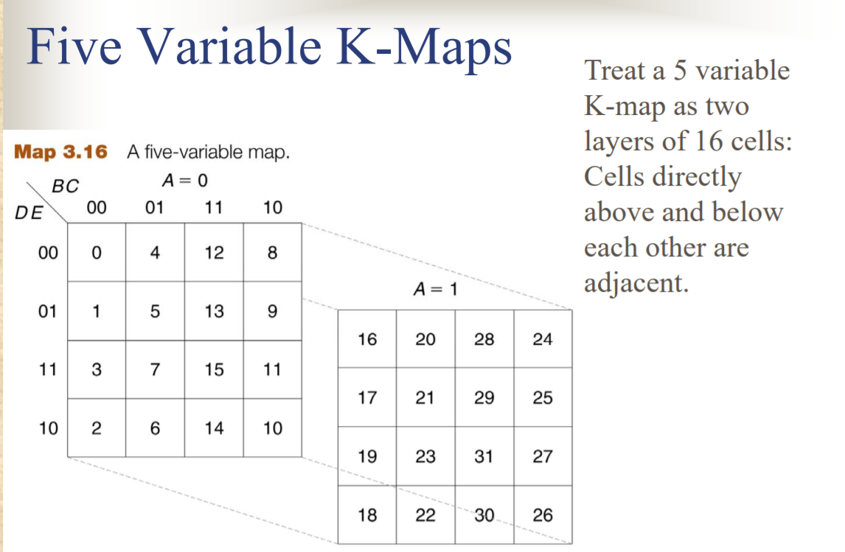

Slide 10
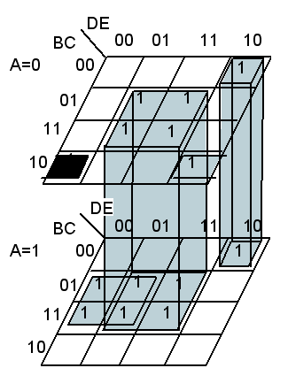
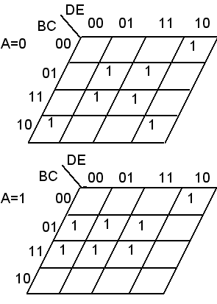
Five–variable Karnaugh map
Example 1:
F(A,B,C,D,E) = ∑m(2,5,7,8,10,13,15,18,20,21,23,28,29 31)
F= C E + A CD’ + B’ C’ D E’+ A’ B C’
=

Slide 11
Five–variable Karnaugh map
Example 3-5/ p 128:
F(V,W,X,Y,Z) = ∑m(3,4,7,9,11,12,15,16,18,19,20,23,24,26,27,28,31).
V=0
V=1
YZ
YZ
WX
00 01 11 10
00 01 11 10
WX
00
01
11
10
0
0
1
0
00
01
11
10
1
0
1
1
1
0
1
0
1
0
1
0
1
0
1
0
1
0
1
0
0
1
1
0
1
0
1
1

Slide 12
Example 3-5/ p 128:
Solution:-
V=0
V=1
YZ
YZ
WX
00 01 11 10
WX
00 01 11 10
00
01
11
10
0
0
1
0
00
01
11
10
1
0
1
1
1
0
1
0
1
0
1
0
1
0
1
0
1
0
1
0
0
1
1
0
1
0
1
1
12

Slide 13
six- Variable K-Maps

Slide 14
AB=00
AB=01
EF
EF
CD
00 01 11 10
CD
00 01 11 10
00
01
11
10
0
1
3
2
₀₀
₀₁
₁₁
₁₀
16
17
19
18
4
5
7
6
20
21
23
22
12
13
15
14
28
29
31
30
8
9
11
10
24
25
27
26
AB=10
AB=11
EF
EF
CD
00 01 11 10
CD
00 01 11 10
00
01
11
10
32
33
35
34
00
01
11
10
48
49
51
50
36
37
39
38
52
53
55
54
44
45
47
46
60
61
63
62
40
41
43
42
56
57
59
58

Slide 15
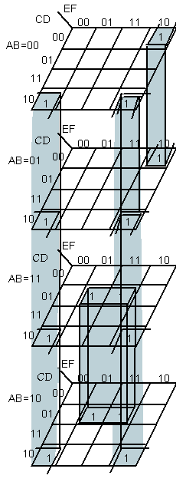
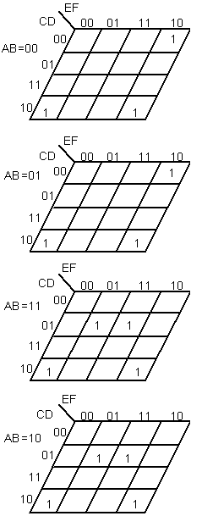
six- Variable K-Maps
Example 1:
F(A,B,C,D,E,F) =Σm(2,8,10,18,24,26,37,39,40,42,
53,55,56,58)
= CD’F’ + AC’ DF+ A’ C’ D’E F’

Slide 16
Example 2:
F(V,W,X,Y,Z)=∑m(4,10,11,14,15,17,18,20,25,26,27,29,30,31,34,36,49,52,53,57,61)
F(V,W,X,Y,Z)=∑m(4,10,11,14,15,17,20,,21,25,26,27,29,30,31,36,49,52,53,57,61)
EF
CD
00
01
11
10
AB = 00
EF
CD
00
01
11
10
AB = 01
00
1
01
11
1
1
10
1
1
00
1
01
1
1
1
1
11
1
1
10
1
1
1
EF
CD
00
01
11
10
EF
CD
00
01
11
10
AB = 10
AB = 11
00
1
01
11
10
00
1
01
1
1
1
1
11
10
1

Slide 17
Example 2: (Continue)
EF
CD
00
01
11
10
AB = 00
EF
CD
00
01
11
10
AB = 01
00
1
01
11
1
1
10
1
1
00
1
01
1
1
1
1
11
1
1
10
1
1
EF
CD
00
01
11
10
EF
CD
00
01
11
10
AB = 10
AB = 11
00
1
01
11
10
00
1
01
1
1
1
1
11
10

Slide 18
Multiple function minimization
F1(A,B,C) = Σm(0,1,2,4,6,).
8-literals
F2(A,B,C) = Σm(1,2,6).
BC
BC
F1= A
00 01 11 10
F2= A
00 01 11 10
0
1
1
1
0
1
0
1
0
1
0
1
1
0
0
1
0
0
0
1
3-literals
1-literal
2-literals
2-literals

Slide 19
Multiple function minimization
F1(A,B,C) = Σm(0,1,3,5,7,9).
F2(A,B,C) = Σm(1,2,6).
3-literal
BC
BC
F1= A
00 01 11 10
F2= A
00 01 11 10
0
1
1
1
0
1
0
1
0
1
0
1
1
0
0
1
0
0
0
1
1-literal
3-literals
2-literals
✓
9-literals

Slide 20
Example 3-6/ p 132:
F1(A,B,C,D) = Σm(4,6,7,8,9,10,11,12,13,14,15)
F2(A,B,C,D) = Σm(4,6,7,8,9,10,11,12)
3-literals
3-literals
CD
CD
F1= AB
00 01 11 10
F2= AB
00 01 11 10
00
01
11
10
00
01
11
10
1
1
1
1
1
1
1
1
1
1
1
1
1
1
1
1
1
1
1
2-literals
1-literal
2-literals
2-literals

